Slide 1
Maps and Sets
Map, Set, HashTable
Data Structures, Fall 2018
TA: Marija Stanojevic

Slide 2
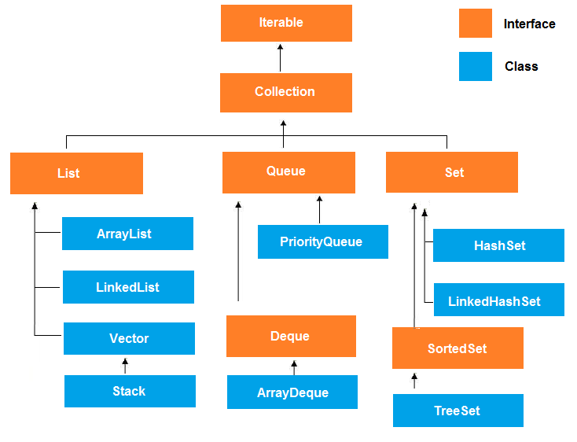
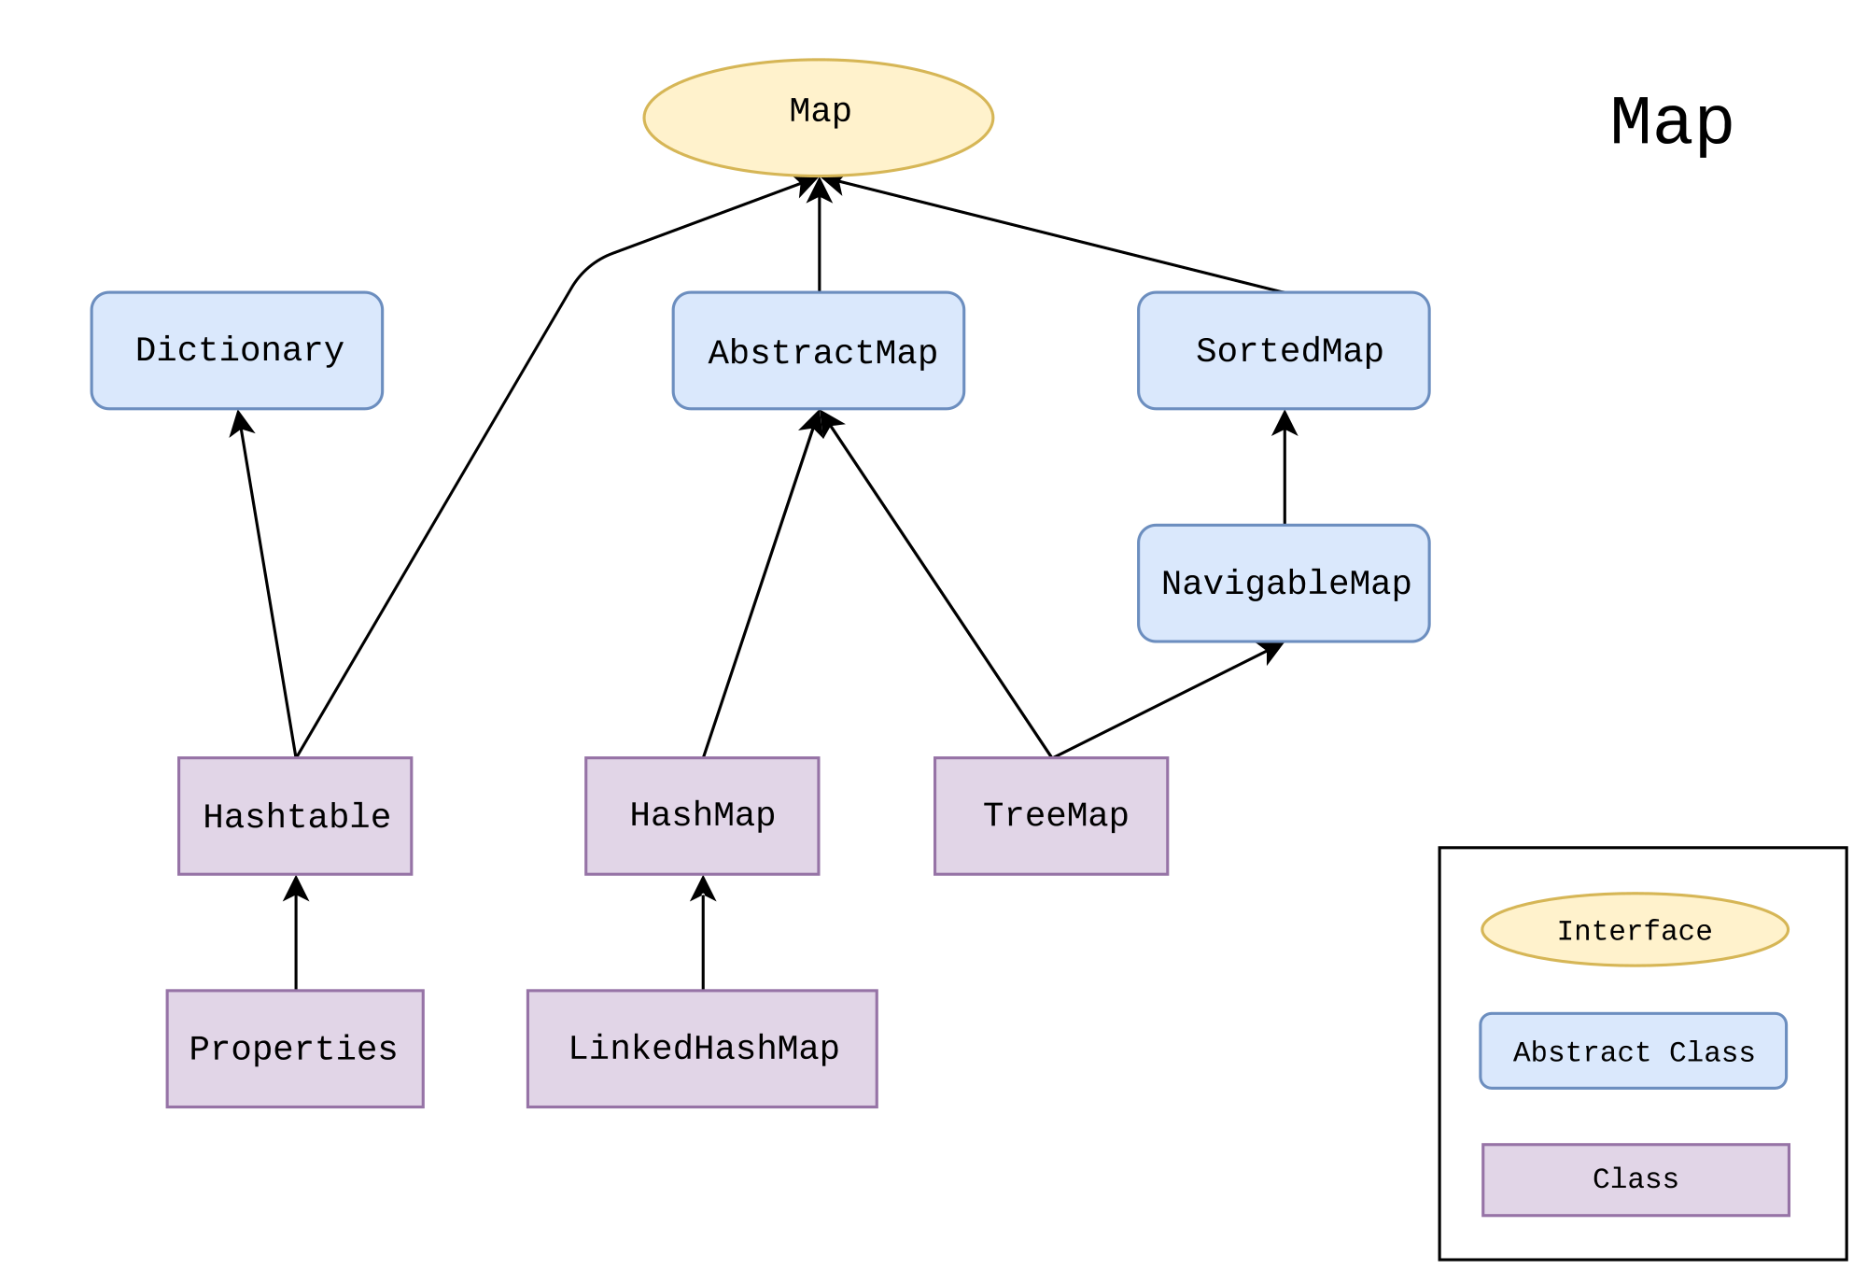
Introduction
Map (or dictionary) is list of (key, value) pairs, where keys are unique
Set is a map which values are unique as well (max 1 null value)
There are many implementations of maps and sets in java API

Slide 3
HashTable
Uses hash function to find position of data
In case position is already taken => collision
Many different algorithms to solve collision
1) chaining => create linked list and with all the elements that should be at that position
2) linear probing => try to put element in next position
3) use second hash function to find next position
Insert / find / remove value in O(1) time - requires good distribution of data
Java API implementations: HashTable, HashMap, HashSet
HashTable is HashMap which doesn’t accept null
Main functions: isEmpty(), get(K key), put(K key, V value), remove(K key), size()

Slide 4


